Slide 1
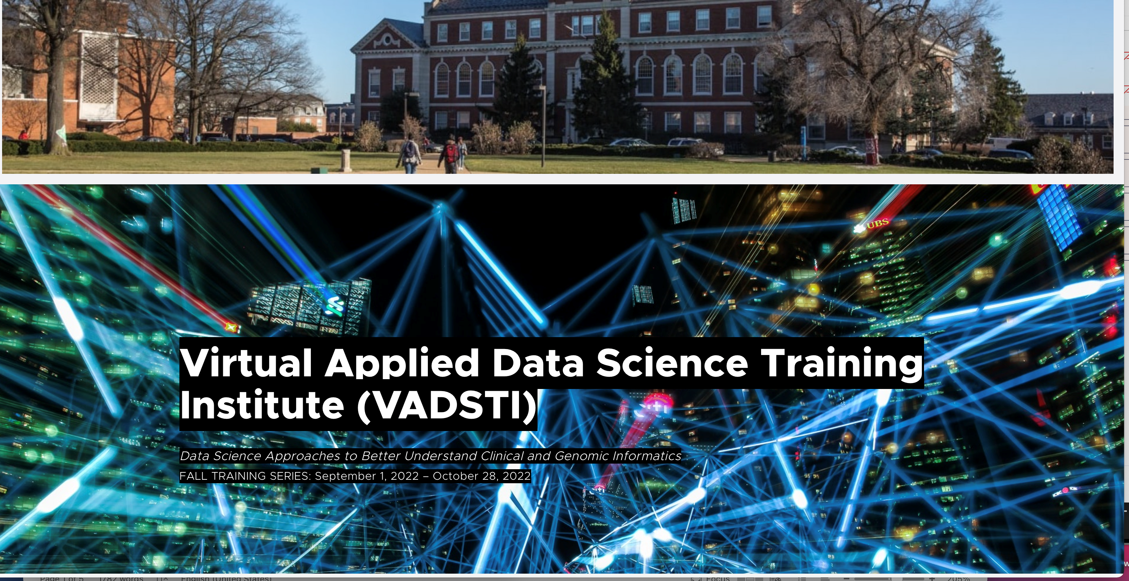
Preprocessing
Moussa Doumbia, Ph.D.
Howard University
Thursday, September 29, 2022

Slide 2
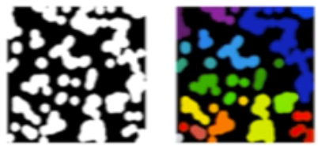
Preprocessing
Encoding
Normalization
Imputation
Selection
Feature Extraction
Dog
Cat
Dog
Bird
0
1
0
2
3
10
5
7
0
1
0.3
0.71
4
3
‘Nan’
2
4
3
3
2
6
3
4
0
1
2
3
4
Sklearn.feature_extraction
sklearn.preprocessing
Sklearn.impute
slearn.feature_selection

Slide 3
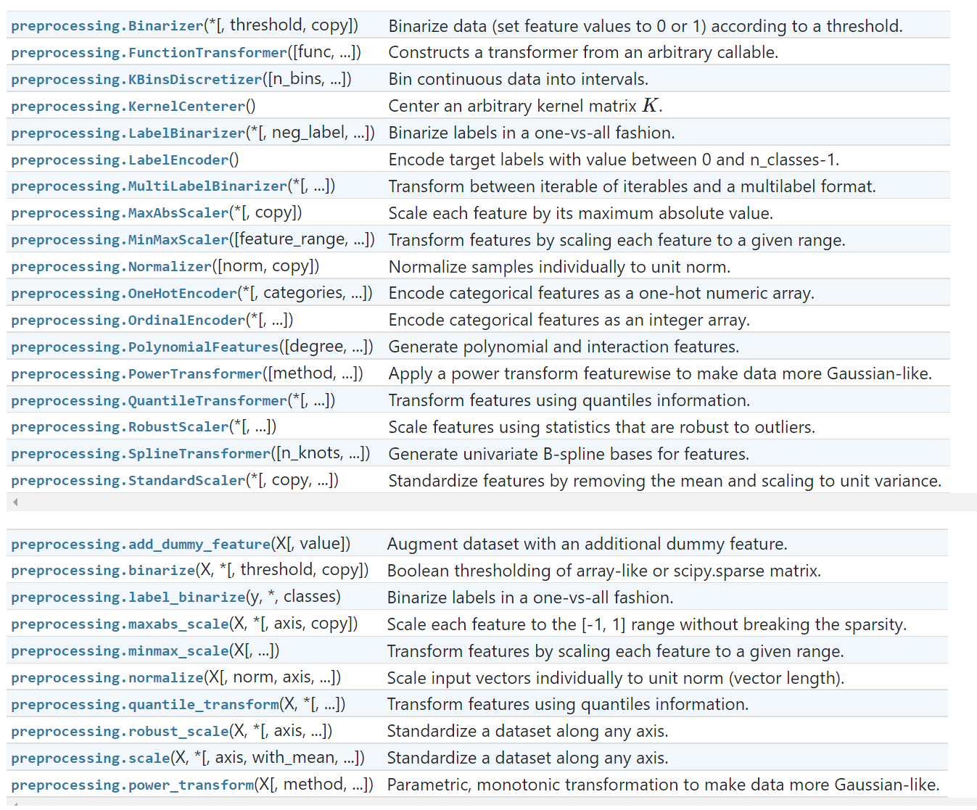

Slide 4

Transformer
Estimator
$$\left(X_{tran},y_{train}\right)$$
$$\left(X_{tran},y_{train}\right)$$
$$\left(X,y \right)$$
Tranformer
Estimator
$$\left(X_{test},y_{test}\right)$$
prediction
$$\left(X_{test},y_{test}\right)$$

Slide 5
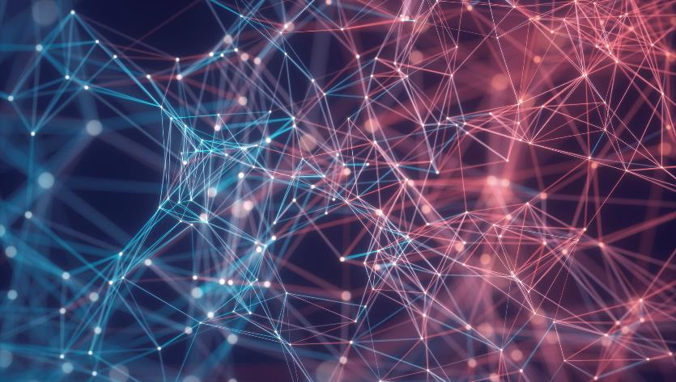

Thank You
Moussa Doumbia, Ph.D.
mdoumbia@howard.edu
www.moussadoumbia.com

